Slide 1

Linked
“Making friends,
just got easier
”
Making friends, just got easier
Team 8:
Ayah Tharwat, Jialin Yu, Krisia Flores

Slide 2
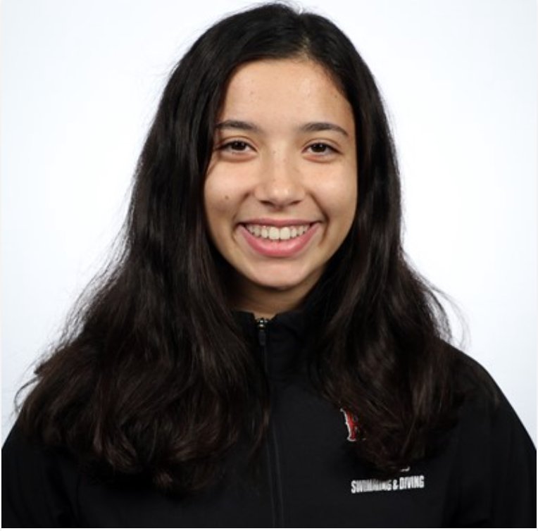
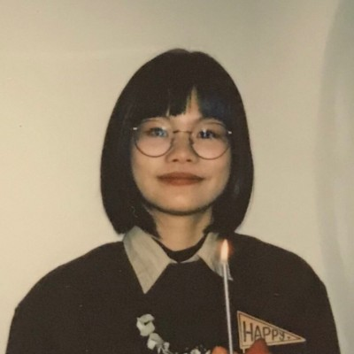
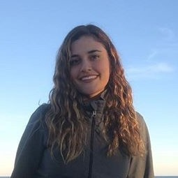

Meet our team
Ayah Tharwat
Jialin Yu
Krisia Flores

Slide 3

Problem
COVID Restrictions
Online classes
People not on campus
No information about clubs besides basics
Notes:
We noticed how hard it was to make friends on campus because of COVID.
A large portion of the sophomore and junior student body weren’t on campus for the majority of their college careers, and hadn’t had the chance to join new clubs or meet new people.
It was difficult to find information about clubs and organizations when the activities fair at the beginning of the year was cancelled and interaction with other students was limited to online classes.
there is the RPI club directory, but it’s hard to know what exactly the club is about without talking to someone in it. While you could go to the online club meetings, for some reason, approaching someone to talk in person is a lot less awkward than un-muting your mic.

Slide 4

Solution
Inspiration from other apps
Tinder
RPI roommate matching
Web application “links” RPI students based on interests with:
Clubs/organizations
Other students
Search bar, filter, percentage matching
Notes:
We found that some people had taken to using dating apps to make new connections with people in the same area based on the other users’ likes and dislikes in their profiles. Loosely based on that, and the RPI roommate matching page, we decided to take a similar approach to making friends on campus.
So we created a web application that helps students connect with each other by creating profiles with their current likes and possible hobbies and interests that suggest the user link to other users or organizations that match that data.
If you know exactly who you are looking for, you can use the search bar. If you are just window shopping, you can use keywords and filters. If you want to connect with people in a certain organization, join the organization and browse through the list of profiles of other people also in organization.

Slide 5


Users and
Stakeholders
Users: RPI students
Stakeholders
Clubs and fraternities/sororities
Parents
RPI administrators
Notes:
target users:all college students at RPI.
While we can foresee this project being useful for other universities, it is best to start small and then scale up
Organizations need members in order to continue to operate, COVID has made it harder for them to be noticed by underclassmen. Being active on this platform would allow them to be discoverable and contactable.
all parents worry about their children being able to make friends and participate in activities in college, and knowing that they have a way to find both would set their mind at ease.
School administrators because parents are usually the ones that finance their child’s education, and having this resource available would make it more likely that parents are onboard with their child coming to RPI.

Slide 6
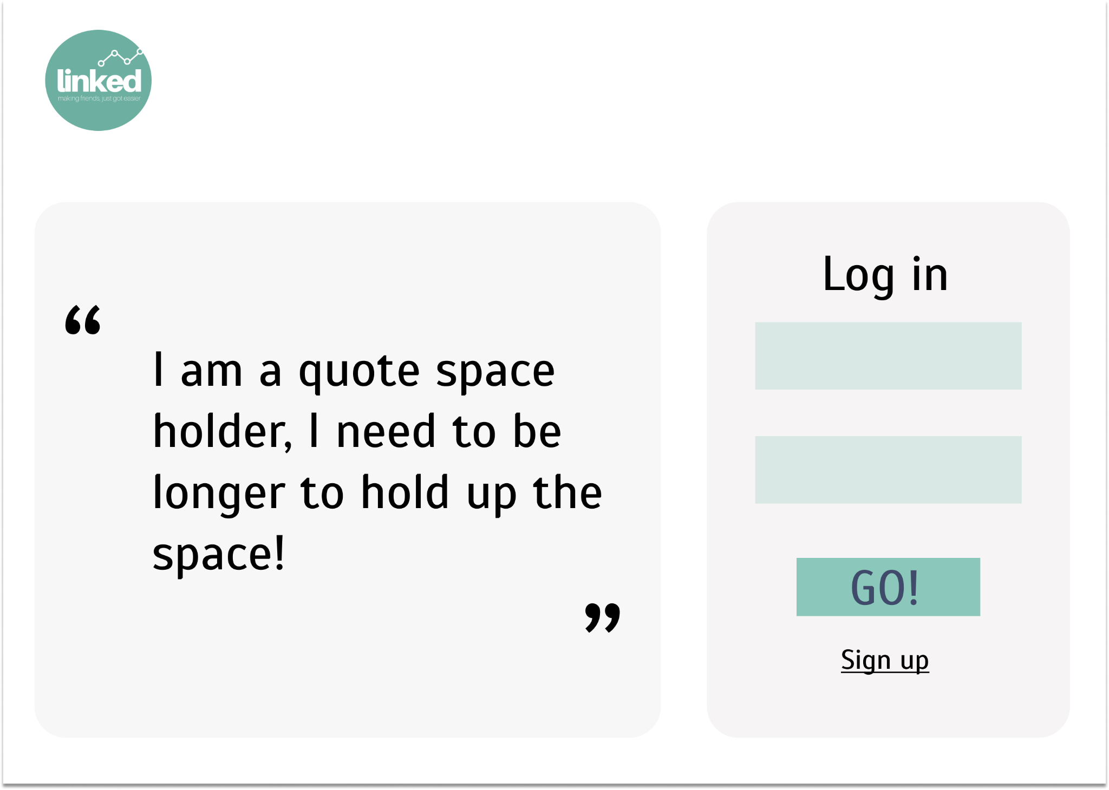
Functional
Requirements
Login/Sign Up
Notes:
The Linked web application includes several functional requirements that will ensure a successful launch. The user will be able to create a personal Linked account and log in using a simple authorization system. The user will have two routes to create an account, either as a student or as an organization.

Slide 7
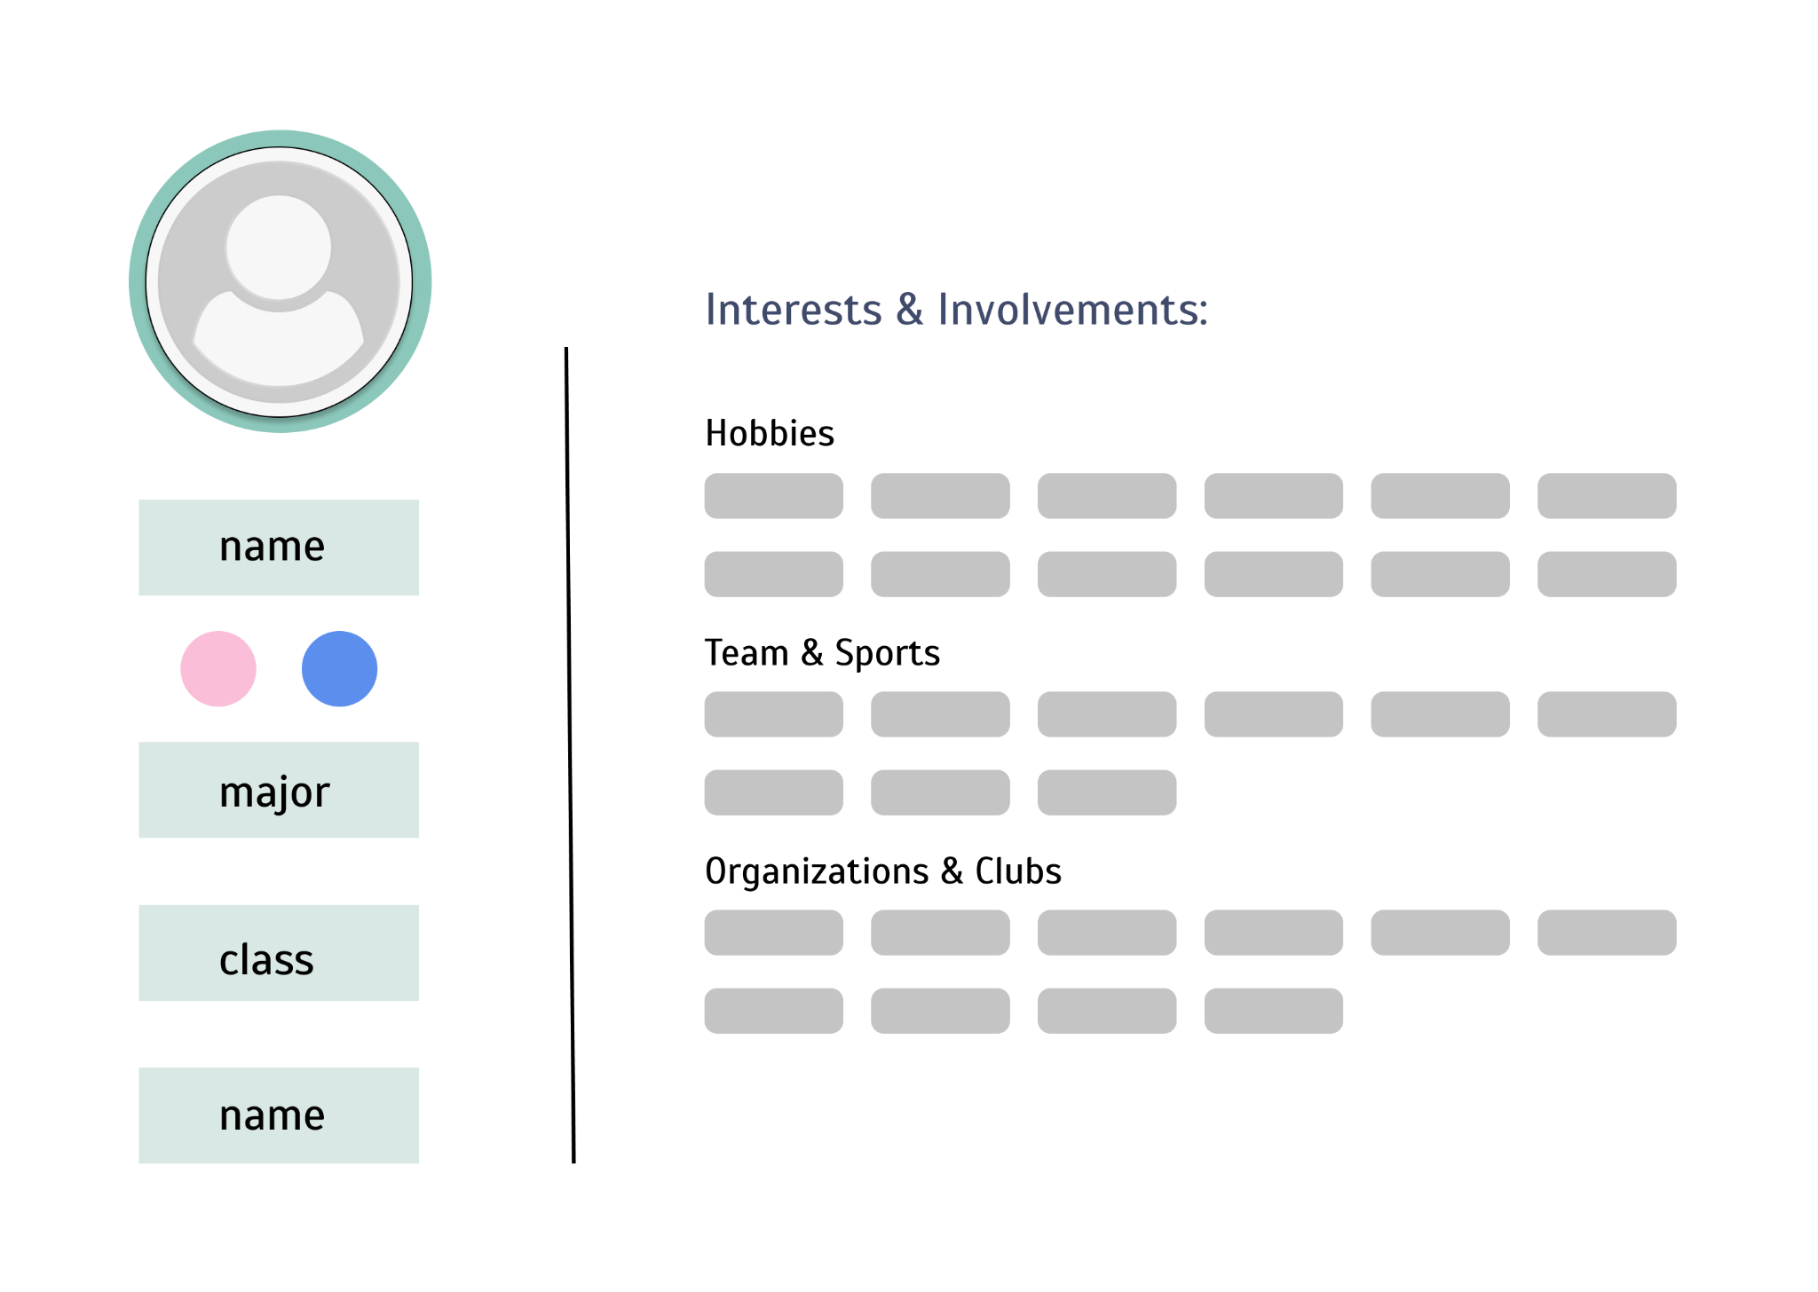
Functional
Requirements
Create an Account
Notes:
Upon a user’s log in, they will be prompted to personalize their profile page by filling in or clicking on choices that pertain to them. Those include hobbies, interset, sports, clubs or organizations the user is part of.

Slide 8
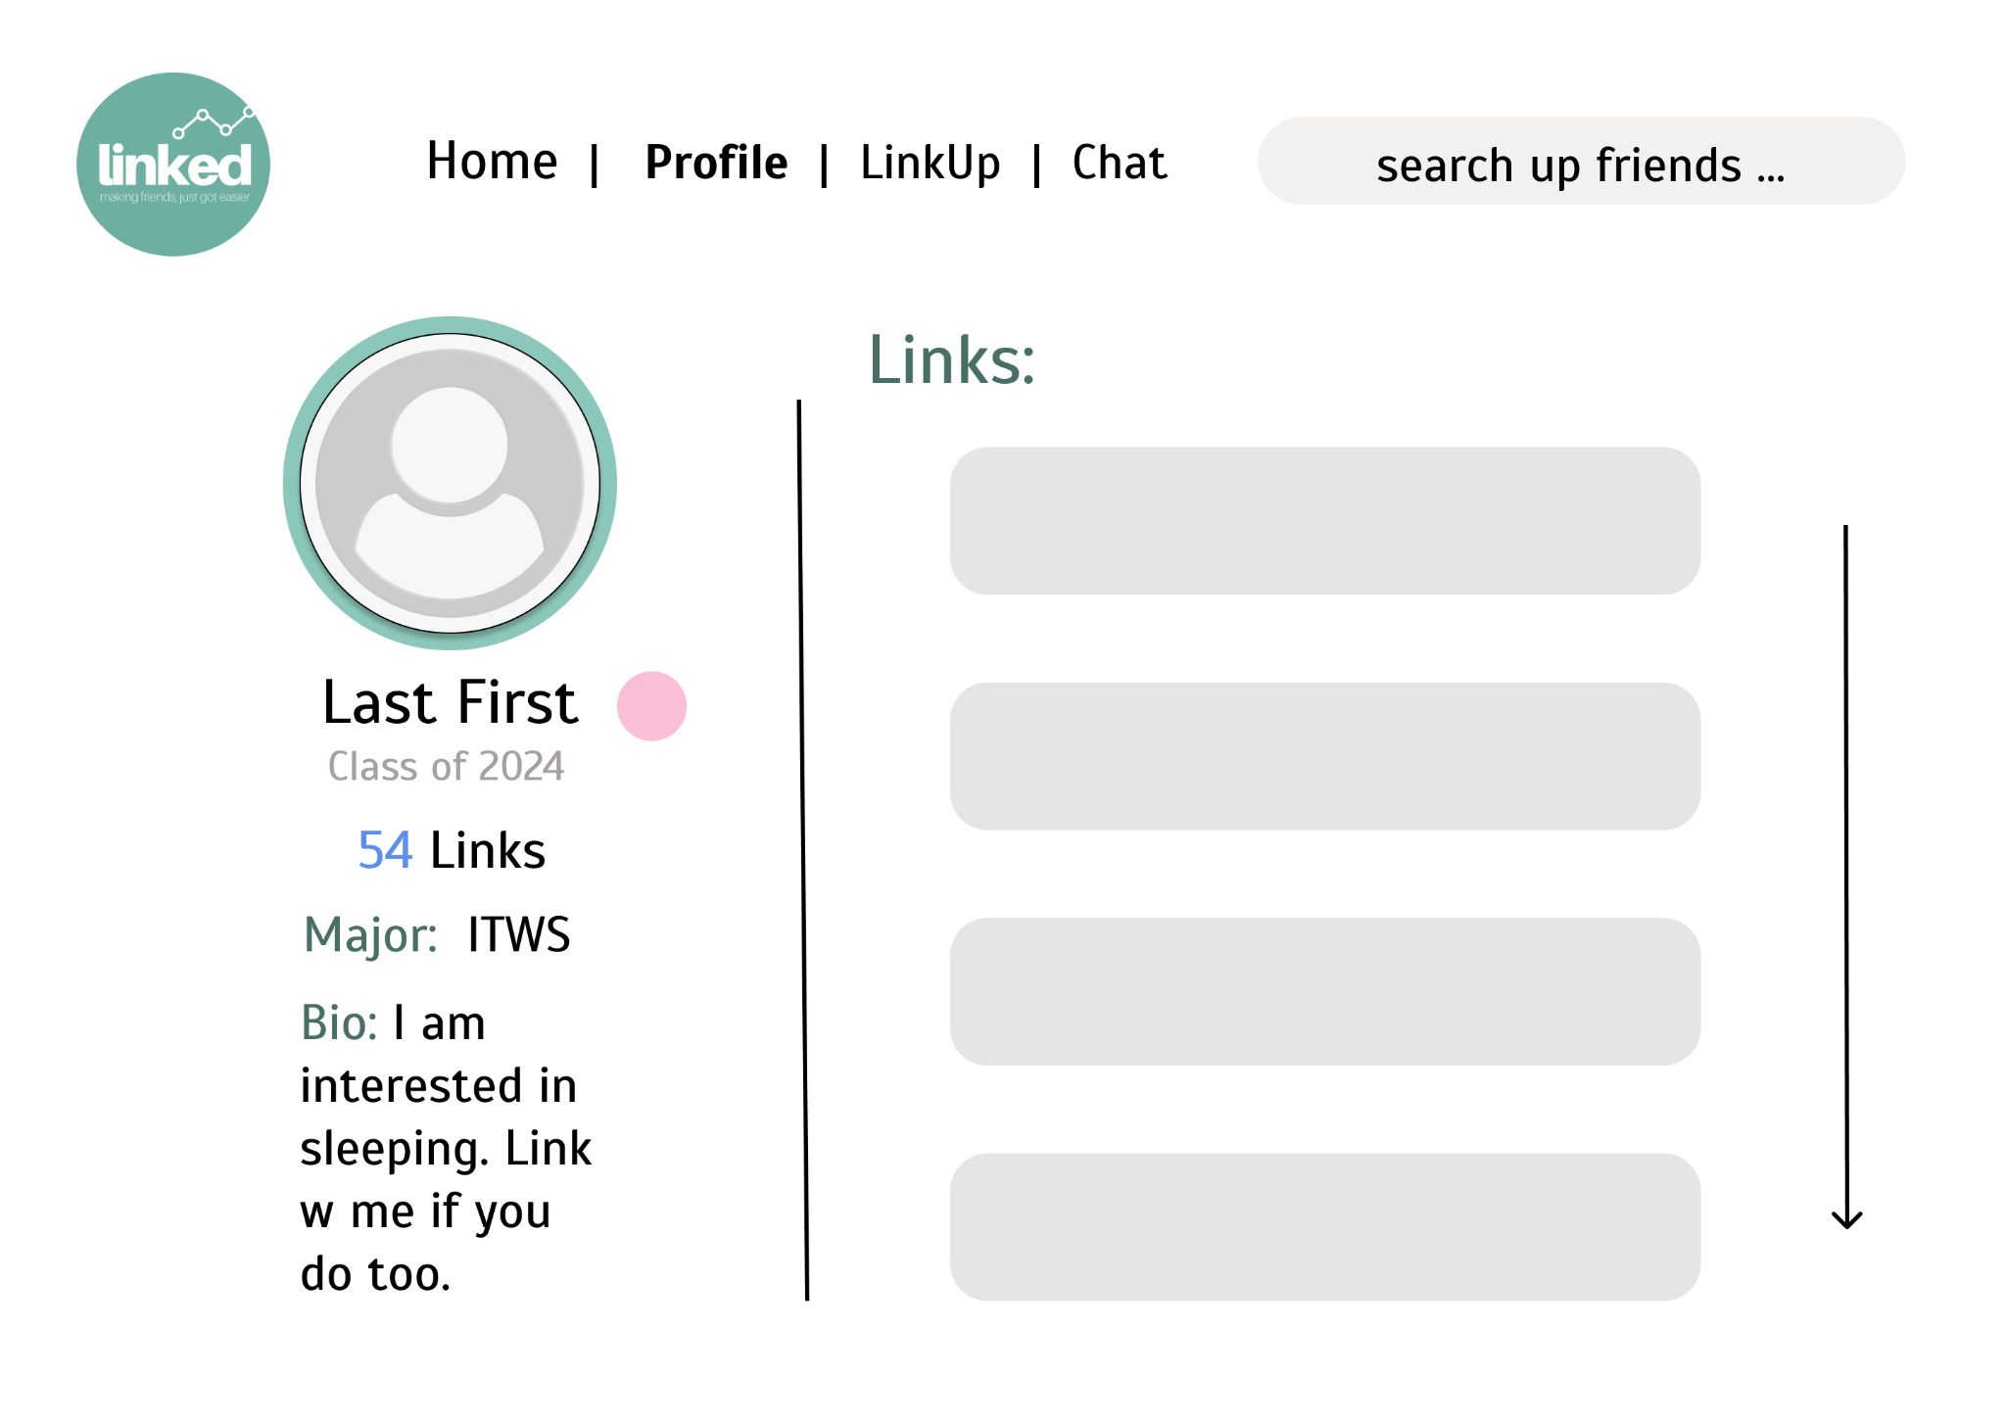
Functional
Requirements
Profile
Notes:
After creating an account, this is what the profile page would look like. It shows your name,major, bio, and how many links you have and this what other users can see if they aren’t linked with u. Once a user links with another, they would be able to view your list of links or friends

Slide 9
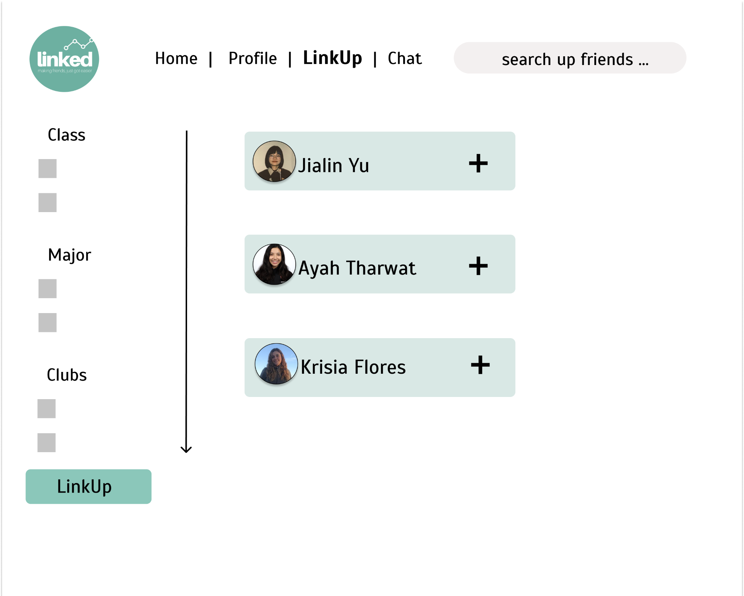
Functional
Requirements
Find “links” using filter or search bar
Notes:
If you want to make more “links” you can easily navigate to the LinkUp page and start using some of our cool features. If you know who and what youre looking for, you can use the search bar to find links. If you are starting fresh, you can use our integrated filter to sift through users by particular categories. Then you could start adding other users. And once you link up with a user, you can start chatting using our live chat feature

Slide 10
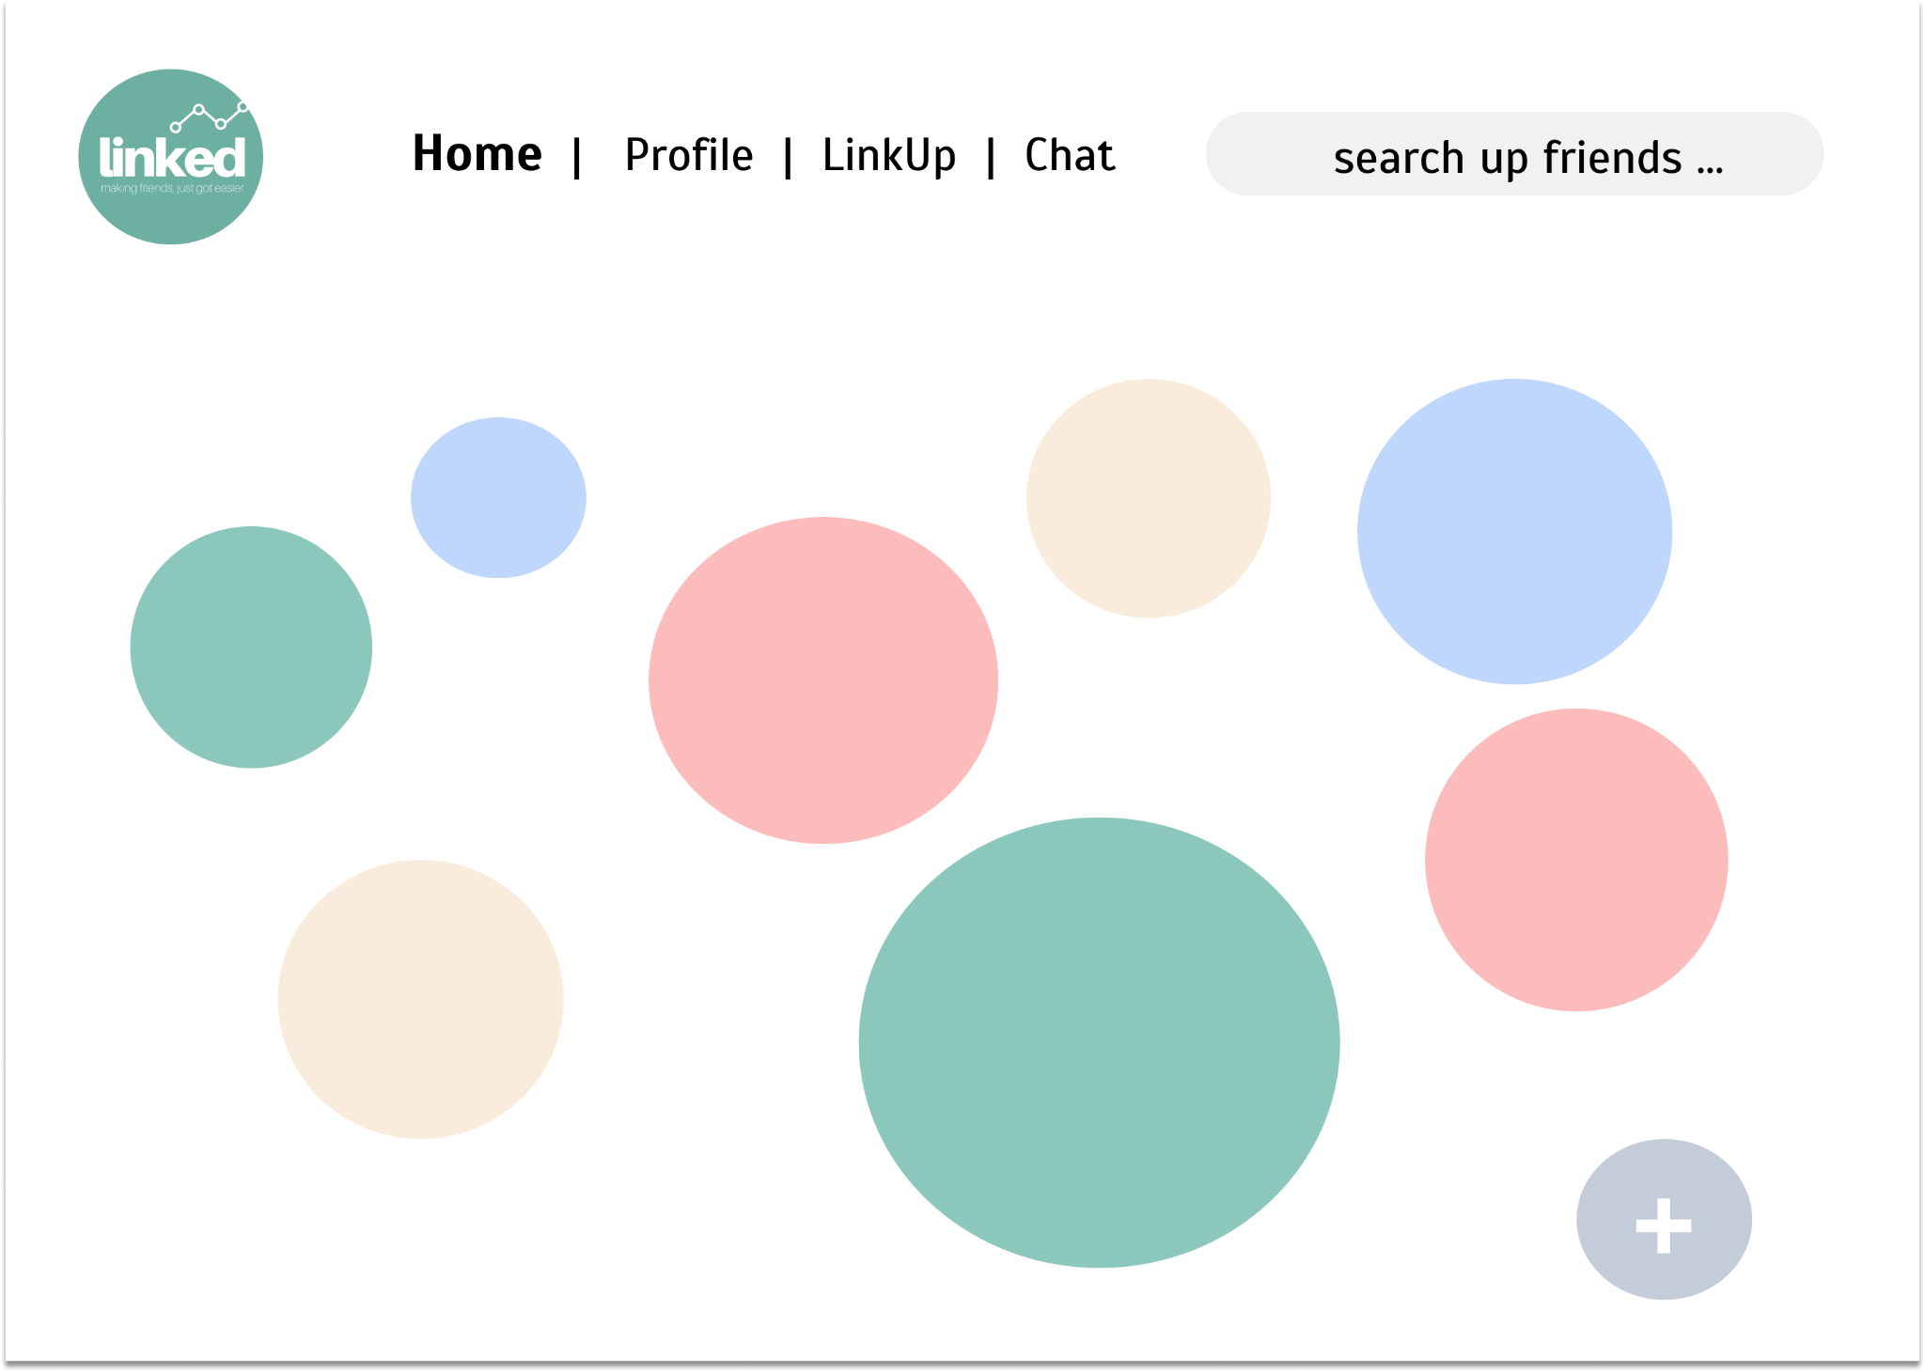
Interesting Technologies
Bubble Animation
Swimmer
Student Gov
Art
ITWS
Notes:
That’s all in terms of our web fundamental requirements but here are two interesting technologies that we will integrate. Once you login, the homepage will include bubble animation to make the website more fun.

Slide 11
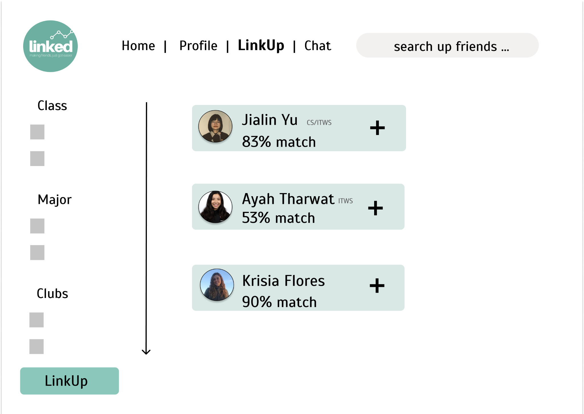
Interesting Technologies
Compatibility Score
MGMT/ITWS
Notes:
Then we have a compatibility score feature that gives you a match score percentage with other users you might be interested in linking with. Now Jialin will go over the Non-functional requirements that make these ideas possible

Slide 12
Non-functional requirements
PHP & MySQL
Notes:
Our web application has several non-functional requirements that include privacy, maintainability, performance, and usability.
Linked prioritizes our users’ privacy. All registered username and passwords will be stored in our database for future login and authorization.

Slide 13
Non-functional requirements
HTML, CSS
Notes:
Users can add more interests using the “+” bubble on the bottom right corner.
We will use HTML and CSS to implement the bubble animation.

Slide 14
Non-functional requirements
Navigation Bar & Search Bar
JavaScript/JQuery

Slide 15
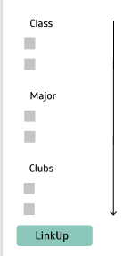
Non-functional requirements
Filter
JS, HTML, CSS

Slide 16

THANK
YOU
Tiktok link: https://vm.tiktok.com/ZMRCuDSY5/

